Slide 1

Fake Tweet Detection Using Machine Learning
Submitted in partial fulfillment of the requirements
of the degree of Bachelor in Engineering
by
Name | Class/Roll No. | Contact No. | Email Id
Deep Furiya | BE-3-16 | 8905202320 | deep.furiya@sakec.ac.in
Ishita Dave | BE-4-05 | 9920215147 | ishita.dave@sakec.ac.in
Hanisha Patel | BE-4-27 | 9819111434 | hanisha.patel@sakec.ac.in
Under the Guidance of
Mrs. Vaishali Hirlekar

Slide 2
Introduction
Nowadays, online social media plays a vital role in real world applications with potentially positive and negative effects. When some event has occurred, many people discuss it on the web through social networking. When unexpected events happen there is also fake news that is broadcasted that creates confusion due to the nature of the events. A new and feasible direction is validating tweets along with media contents using data mining techniques.The proposed framework consists of two major components: classifiers and neural network. Classifier is responsible for classifying the tweet content and constructing a feature set whereas the neural network is to provide previous tweet credibility predictions stored in the memory.

Slide 3
Literature Review
Sr. No. | Author/Title/Year | Work done/Algorithm/Concept/Idea presented in the paper | Remarks
1 | Weiling Chen, Chenyan Yang, Yan Zhang, Chai Kait Yeo, Chiew Tong Lau, Bu Sung Lee/ Exploiting Behavioral Differences to Detect Fake News/ 2018 | Autoencoder and Recurrent Neural Network Accuracy:87% | It deals with real-world behavioral patterns thus, the accuracy decreases.
2 | Youngkyung Seo, Deokjin Seo, Chang-Sung Jeong/ Fake news Detection Model using Media Reliability/ 2018 | Modified CNN Deep Learning MNIST:100% Refined:97.7% Media: 75.6% | As the deception of news was verified by people, it is a limitation also the lack of dataset and the output result utilized a lot of time.

Slide 4
3 | HrishikeshTelang,Shreya More, Yatri Modi, Lakshmi Kurup/ Anempirical Analysis of Classification Models for Detection of Fake News Articles/ 2019 | Classifiers and Neural Networks Logistic Regression:91% LSTM:89% | There is a limitation on the amount of space that can be availed to maintain a record of all computations in the network’s history, a significant proportion of which may not end up being productive
4 | Jiawei Zhang, Bowen Dong, Philip S. Yu/ Effective Fake News Detection with Deep Diffusive Neural Network/ 2019 | Deep Diffusive Network Model Accuracy:63% | They usually rely on local structures without considering global manifold information and they fail to scale to large datasets due to prohibitive memory consumption and computational burden due to intrinsic high-order operations on the whole graph

Slide 5
5 | Sahil Gaonkar, Sachin Itagi, Rhethiqe Chalippatt, Avinash Gaonkar, Shailendra Aswale, Pratiksha Shetgaonkar/ Detection Of Online Fake News : A Survey/ 2019 | NLP and machine learning techniques Naïve Bayes: 74% Support Vector Machine: 82% Multilayer Perceptron: 96.55% | The URL is the main key for the detection, so if there is not proper data provided through the url of the news then the prediction would be not accurate
6 | Saranya Krishnan, Min Chen/ Identifying Tweets with Fake News/ 2018 | J48 decision tree classifier and SVM Accuracy : 80.25% | The calculations made on the Twitter Api features should be made correctly or else the accuracy may decrease

Slide 6
Problem Statement
The project is concerned with identifying a solution that can be used to detect and filter out tweets containing fake news.
Make a system for the user to make accurate decisions and thus possibly avoid spreading misinformation.

Slide 7
Objectives
1. To develop an efficient approach for fake tweet detection with statistical and neural network methods to analyze, detect or intervene with fake tweets and thus enabling the user to make informed decisions and thus possibly avoid spreading misinformation.
2.To analyze the efficiency of the proposed system

Slide 8
Two Phase Implementation
PHASE 1(Processing on Tweet): In phase one, we will input the features related to the tweet i.e the text content, the title of the tweet, label associated to the respective tweet whether it is false or true to a classifier: Naive Bayes or Passive Aggressive Classifier. Phase one contains the normal feature extraction method. For better results we will also implement phase two i.e. feature extraction from the user profile.
PHASE 2(Processing on User Profile): In phase two, apart from the basic features related to the tweet, we will also input the features related to the twitter account holder i.e retweet count, followers count, friends count, etc for better accuracy to predict the correct best outcome. On the basis of our literature review, Decision Tree Algorithm best suites for this feature extraction.

Slide 9
Dataset Analysis
This dataset contains the Tweets of users from 29-03-2020 to 15-04-2020 who have applied the following hashtags: #coronavirus, #coronavirusoutbreak, #coronavirusPandemic, #covid19, #covid_19, #epitwitter, #ihavecorona. From about 11 April 2020, the dataset also included the following additional hashtags: #StayHomeStaySafe, #TestTraceIsolate. The dataset contains variables associated with Twitter: the text of various tweets and the accounts that tweeted them, the hashtags used and the locations of the accounts. Dataset does not include retweets (although a count of retweets is provided as a variable).

Slide 10
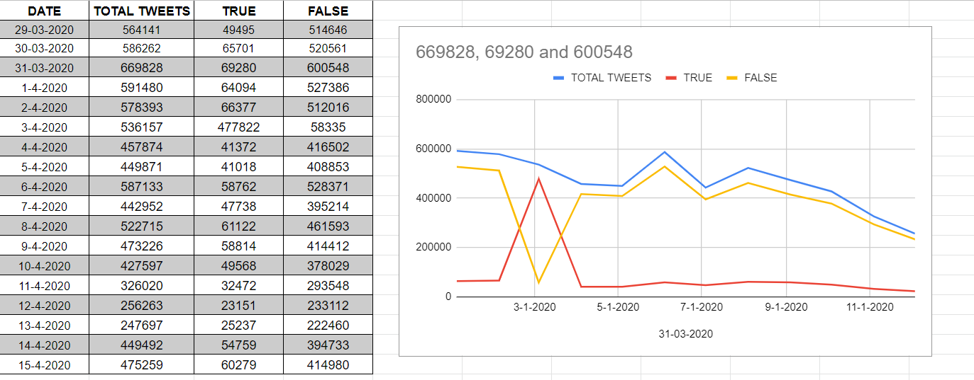
Covid-19 Twitter Dataset

Slide 11
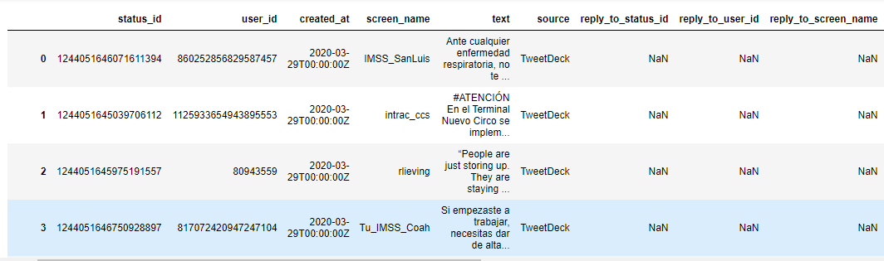
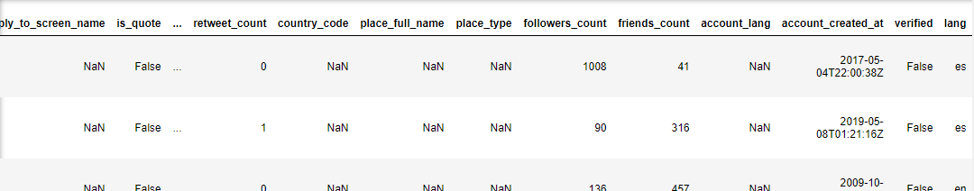
Dataset Analysis
Following are the Features included in the current dataset.
Total : 20

Slide 12
Features Considered from Dataset
Tweet’s text (includes hashtags)
True / False
Tweet - Favorites
Retweet Count
User’s Followers
User’s Friends count
Total Features : 6
Used For Phase-I
Phase-II Implementation

Slide 13
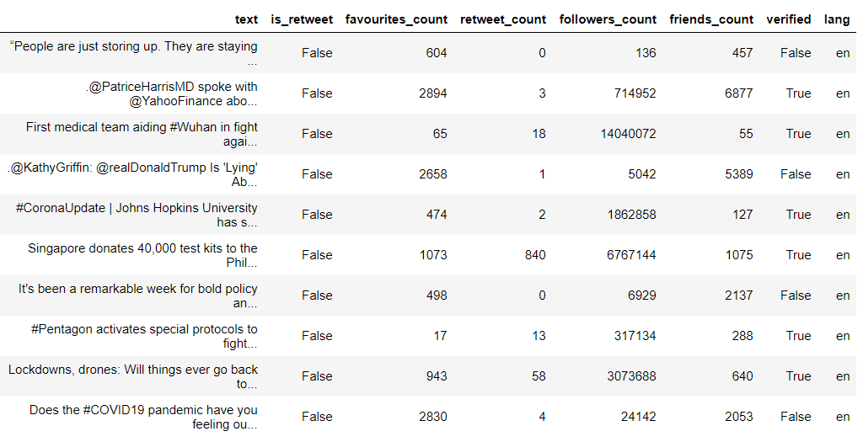
Feature Set

Slide 14
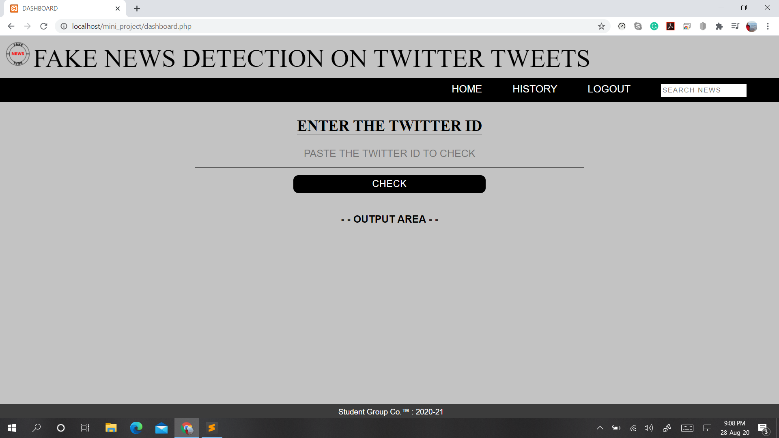
Input From User

Slide 15
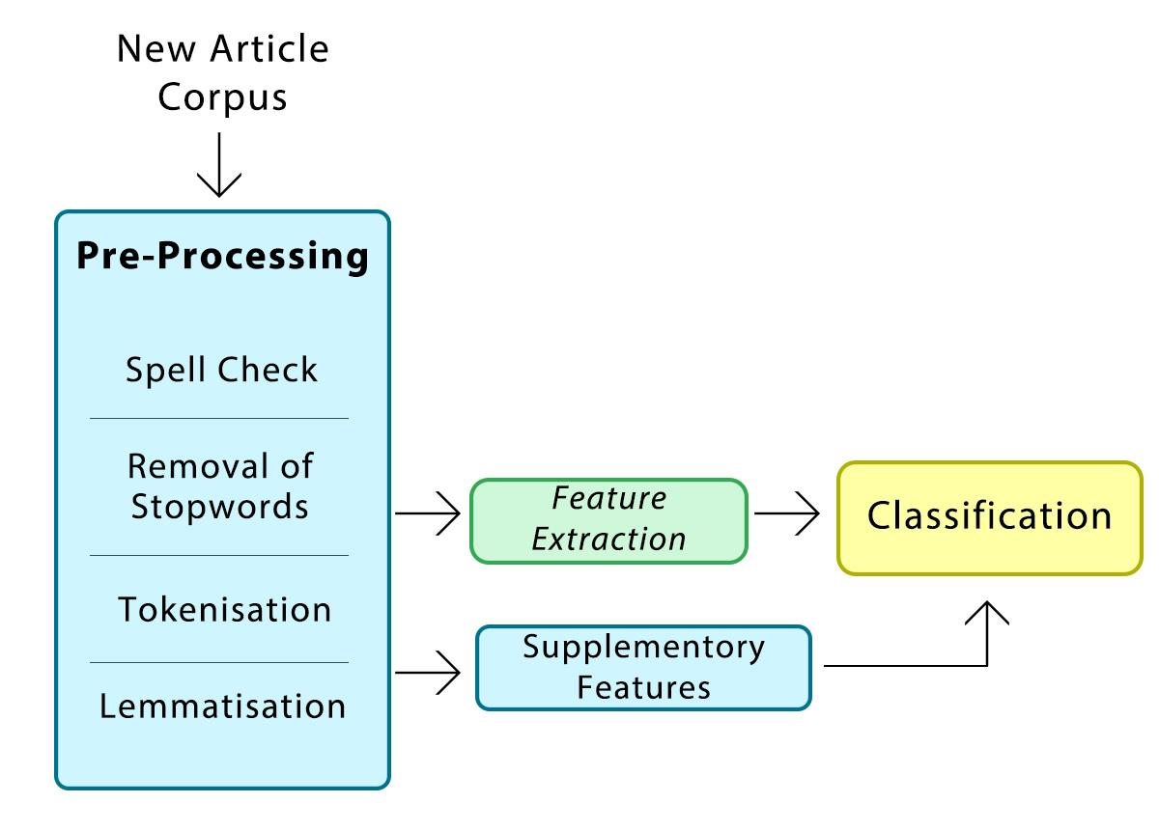
Block Diagram

Slide 16
Proposed Methodology
News Article Corpus: Contains dataset of tweets to be predicted.
Pre-Processing: Step where data gets transformed into a state which can be easily interpreted by the algorithm.
Supplementary feature: Features that refer to the property of Twitter users who issued the tweet and capture the content representations.
Feature Extraction: Aims to reduce the number of features in a dataset by creating new features from existing ones.
Classifiers: It is responsible for classifying tweets as fake or real based on the feature set extracted. Various classifiers can be used like support vector machine, logistic regression or random forest.
Neural network: Neural networks,considered to have a certain amount of memory in which they store all preceding calculations, employ information gathered from each element in the sequence.

Slide 17
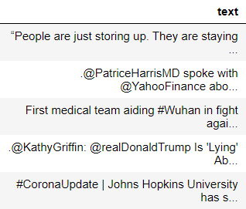

We have divided our process into 2 parts : Processing on tweet & Processing on the users profile.
PHASE 1 : PROCESSING ON TWEET
The first phase i.e., Processing on the text will be done in the pre-processing part and the text will be tokenized and the features would be extracted from the tweet and then provided to the classifier.
The classifier going to be used will be Naive Bayes / Passive Aggressive Classifier.
Dataset :
Text
Verified

Slide 18
Implementation (Phase - I)
Passive Aggressive Classifier
Naive Bayes Classifier

Slide 19
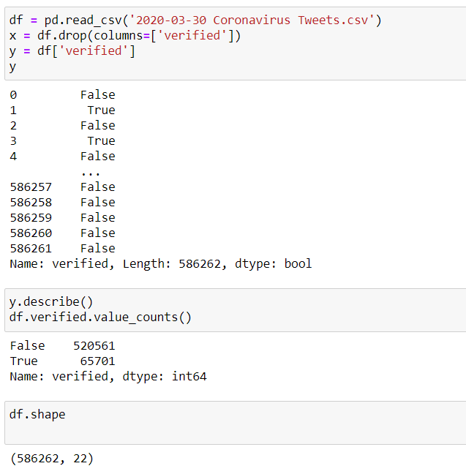
Phase -I Implementation
Step 1: Dataset Analysis
Experiment 1
Passive Aggressive Classifier

Slide 20
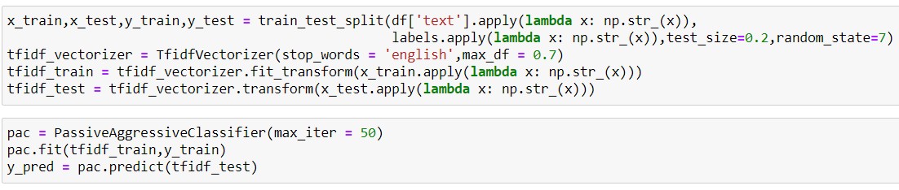
Implementation:
Step 2: Data pre-processing and fitting the model to Passive Aggressive Classifier

Slide 21
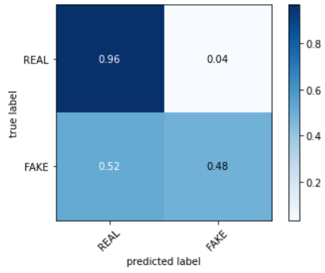
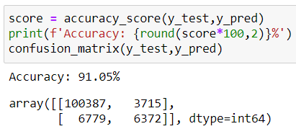
Implementation:
Step 3: Predict the accuracy and confusion matrix and plot

Slide 22
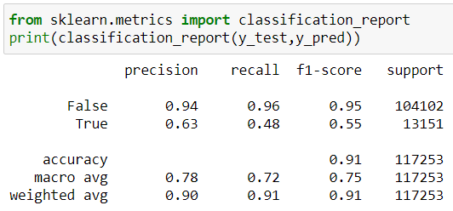
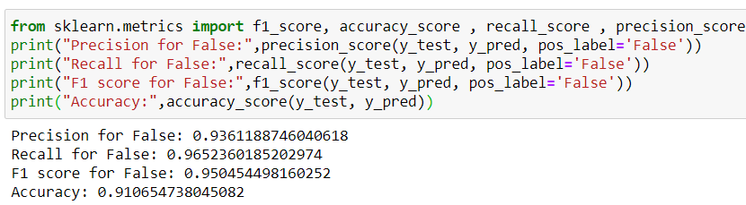
Implementation:
Step 4: Calculating precision, recall and F1 score

Slide 23
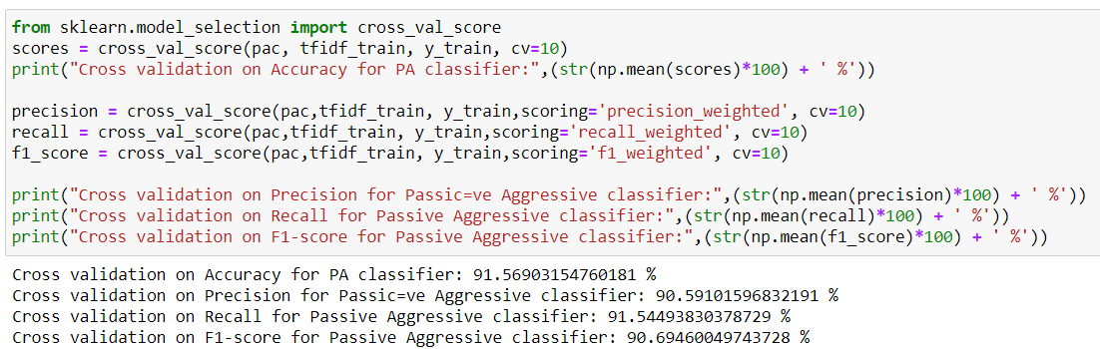
Implementation:
Step 5: Cross Validation

Slide 24
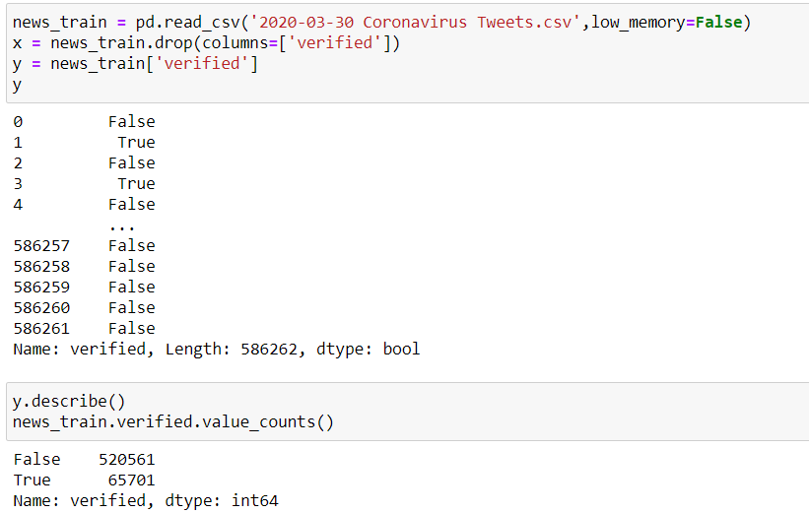
Implementation:
Step 1: Dataset Analysis
Experiment 2
Naive Bayes Classifier

Slide 25
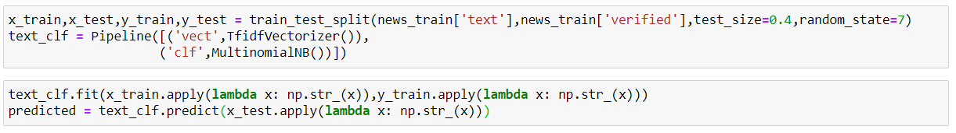
Implementation:
Step 2: Data pre-processing and fitting the model to Naive Bayes Classifier

Slide 26
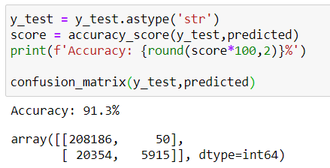
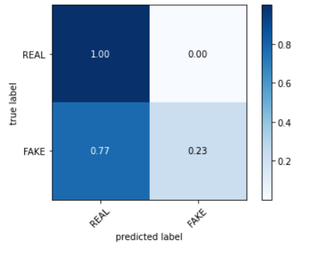
Implementation:
Step 3: Predict the accuracy and confusion matrix and plot

Slide 27
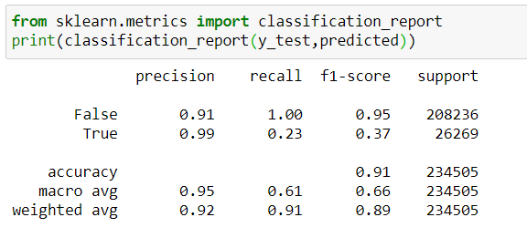
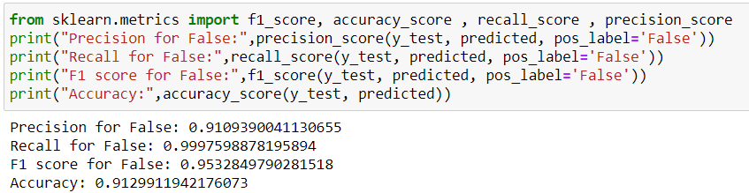
Implementation:
Step 4: Calculating precision, recall and F1 score

Slide 28
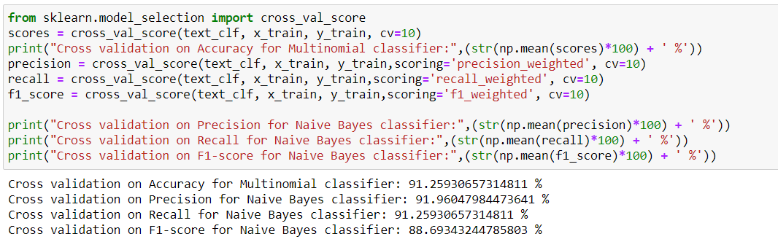
Implementation:
Step 5: Cross Validation

Slide 29
Experimental Result Summary : Phase - 1
Algorithm | Precision % | Recall % | Accuracy % | F1-Score %
Passive Aggressive | 90 | 91 | 90.37 | 91
Naive Bayes | 92 | 91 | 92.36 | 89

Slide 30
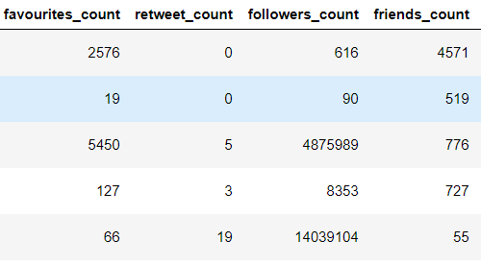
PHASE 2 : PROCESSING ON USER PROFILE
In phase 2, the user profile and tweet features, i.e, followers count, retweet count, favourite count, friends count, verified, these characteristics are taken into consideration.
Further, these features are provided to Decision Tree Classifier for further evaluation.
Dataset :
Favourites Count
Retweet Count
Followers Count
Friends Count

Slide 31
Implementation (Phase - II)
Passive Aggressive Classifier
Logistic Regression Classifier
Decision Tree Classifier

Slide 32
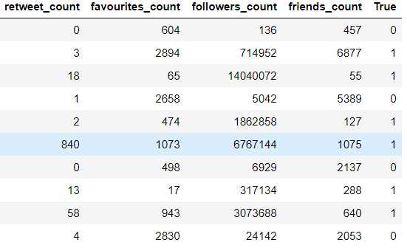

Phase-II Implementation:
Step 1: View Feature set in
the dataset

Slide 33
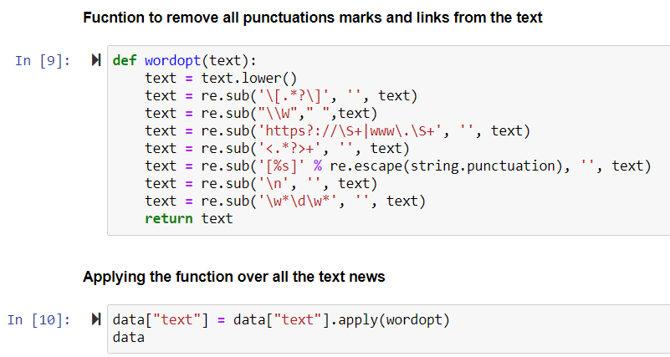
Step 2 : Data pre-processing & splitting dataset

Slide 34
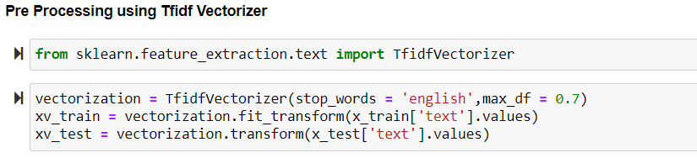
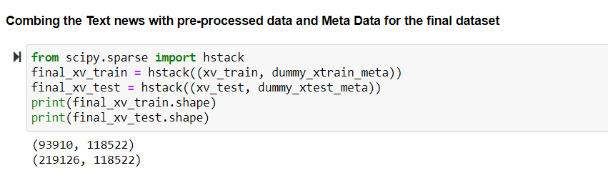

Slide 35
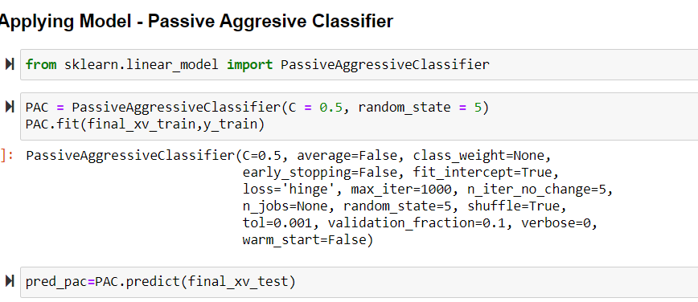
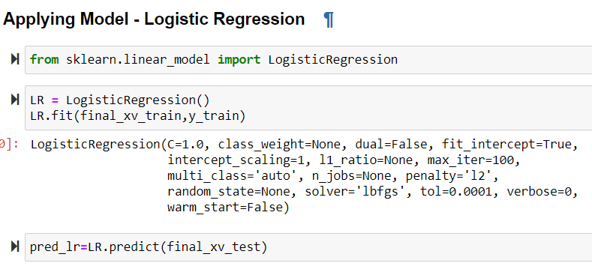
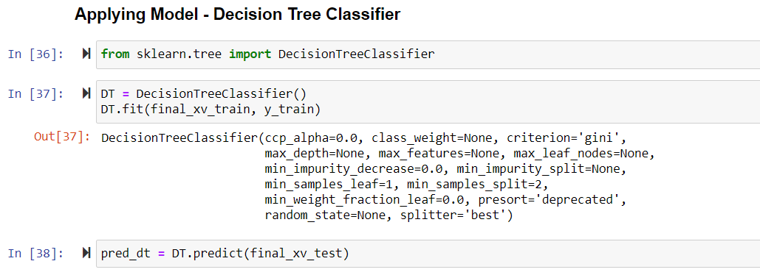
Step 3 : Fitting The final dataset to the classifier

Slide 36
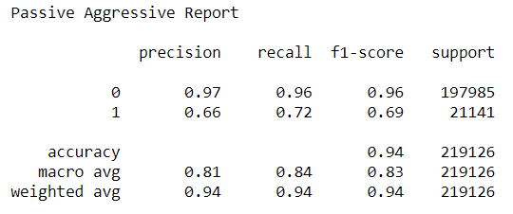
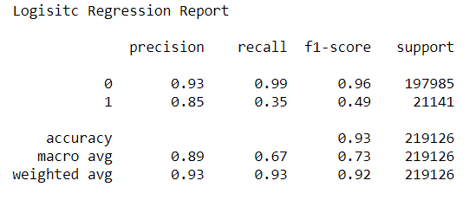
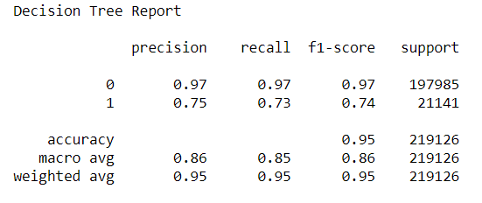
Step 4: Classifier Report

Slide 37
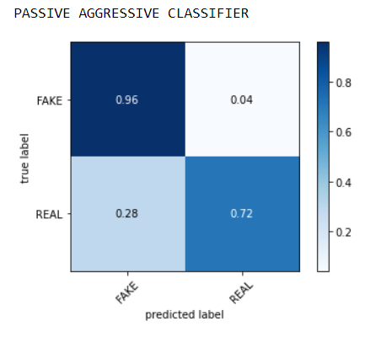
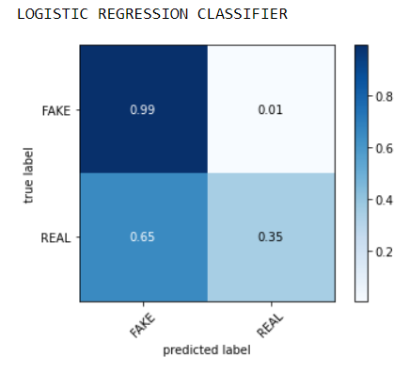
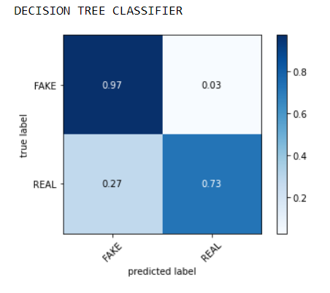
Step 5: Confusion Matrix

Slide 38
Experimental Result Summary
Algorithm | Precision % | Recall % | Accuracy % | F1-Score %
Passive Aggressive | 96 | 91 | 88.96 | 94
Decision Tree | 97 | 97 | 94.94 | 97
Logistic Regression | 93 | 99 | 93.10 | 96

Slide 39
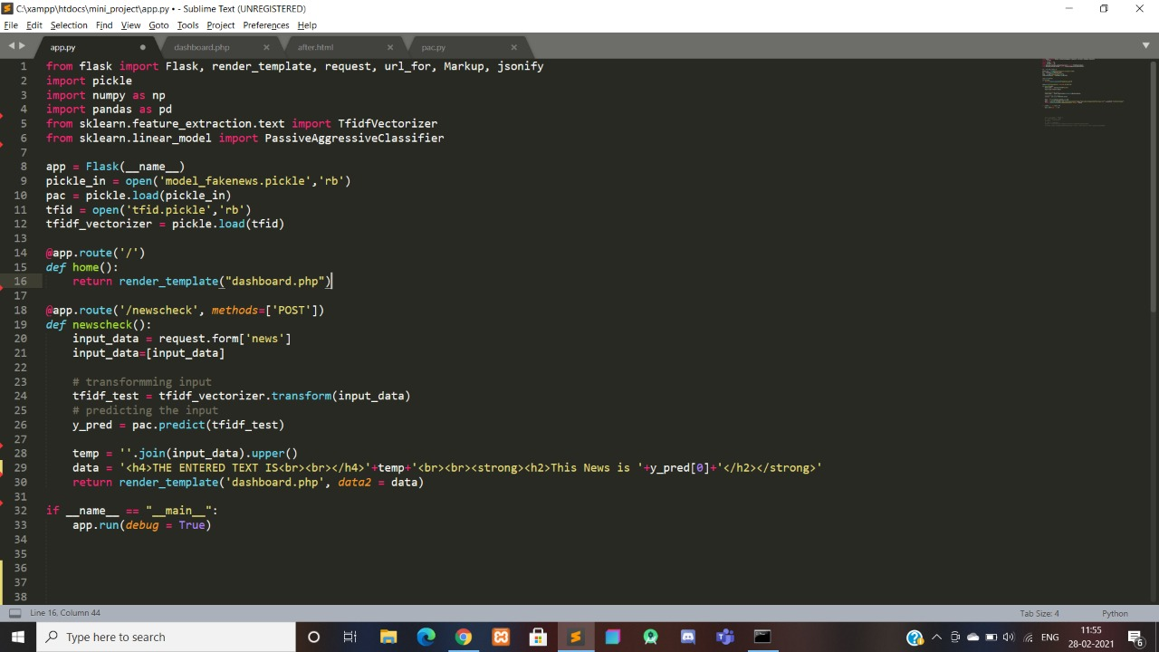
Connectivity between GUI and Backend

Slide 40
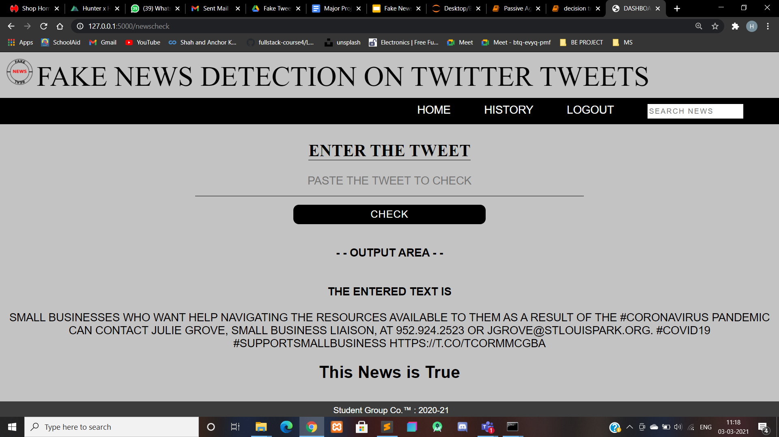
Using Passive Aggressive Classifier

Slide 41
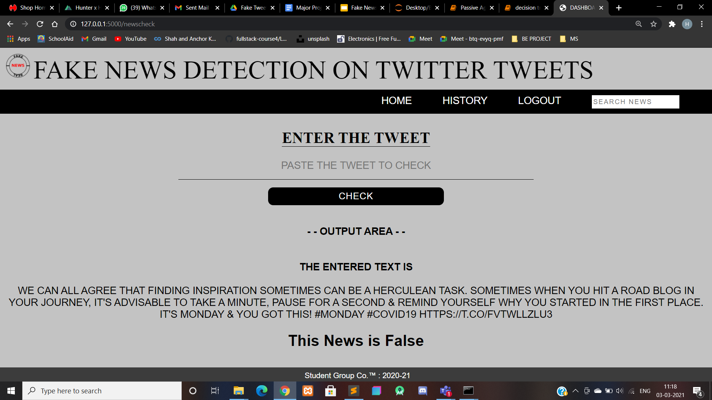
Using Passive Aggressive Classifier

Slide 42
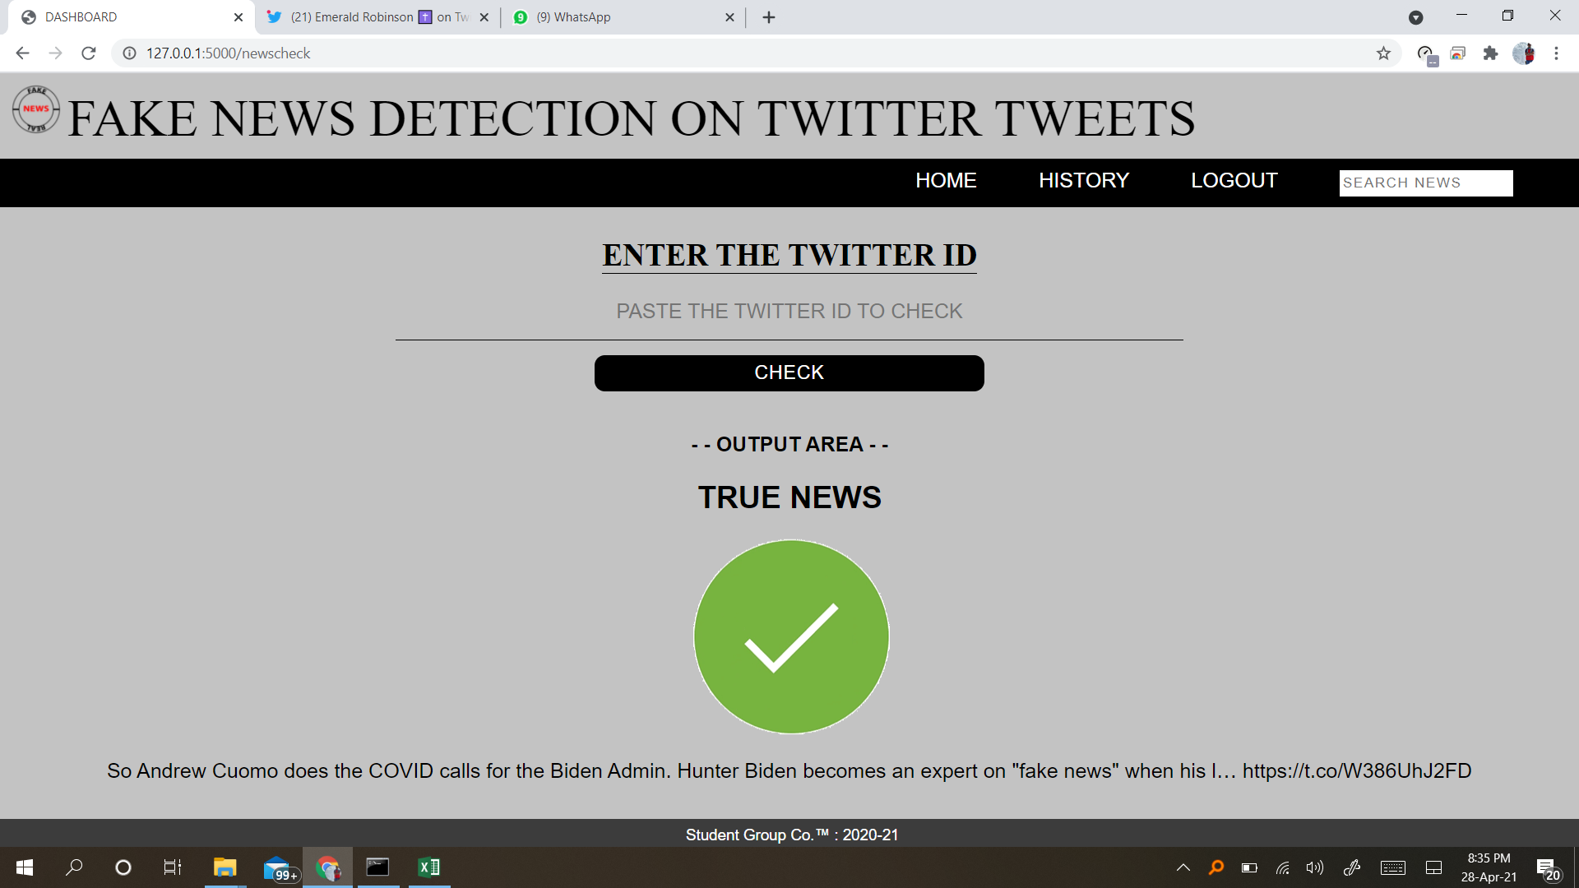
Using Decision Tree Classifier

Slide 43
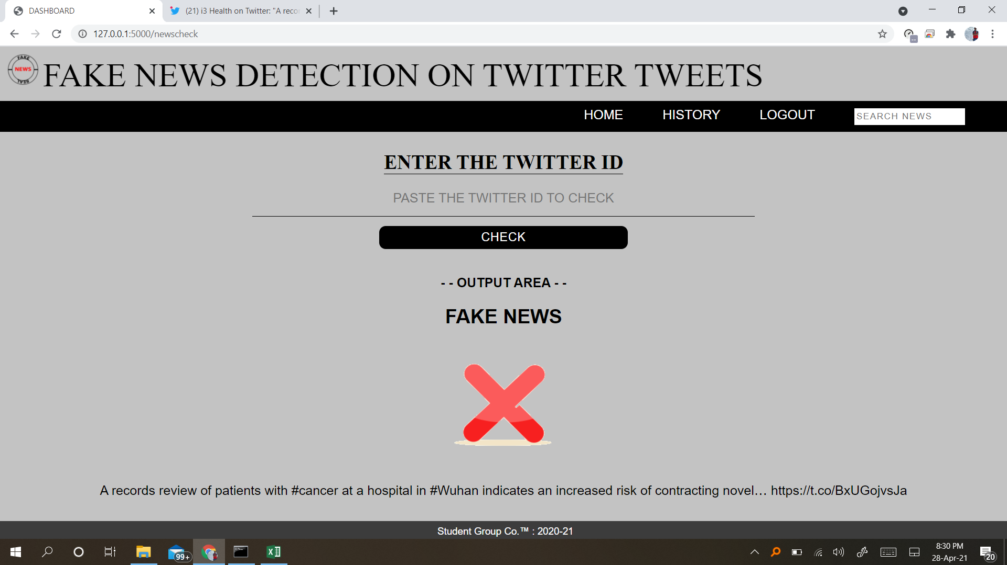
Using Decision Tree Classifier

Slide 44
Conclusion
We created a generalized framework in order to predict tweet credibility. Study finds much more fake news activity than several recent studies, largely because it examines a larger corpus of fake and conspiracy news sites.
In our project, we present a comprehensive review of detecting fake news on twitter, existing algorithms from a data mining perspective, evaluation metrics and representative datasets.
Fake news detection on twitter presents unique characteristics and challenges that make existing detection algorithms from traditional news media ineffective or not applicable. Because the issue of fake news detection on social media is both challenging and relevant, we conducted this survey to further facilitate research on the problem.

Slide 45
References
[1] Weiling Chen,Chenyan Yang,Yan Zhang,Chai Kait Yeo,Chiew Tong Lau,Bu Sung Lee, “Exploiting Behavioral Differences to Detect Fake News”, 2018
[2]Youngkyung Seo, Deokjin Seo,Chang-Sung Jeong, “Tencon-2018,IEEE 2018 Region 10 Conference.”, 2018
[3]HrishikeshTelang,Shreya More, Yatri Modi, Lakshmi Kurup, “Anempirical Analysis of Classification Models for Detection of Fake News Articles”, 2019
[4]Jiawei Zhang, Bowen Dong, Philip S. Yu, “Effective Fake News Detection with Deep Diffusive Neural Network”, 2019
[5]Sahil Gaonkar,Sachin Itagi,Rhethiqe Chalippatt,Avinash Gaonkar,Shailendra Aswale, Pratiksha Shetgaonkar, “Detection Of Online Fake News : A Survey”, 2019
[6]Saranya Krishnan, Min Chen, “Identifying Tweets with Fake News”, 2018

Slide 46
Thank You...

